Slide 1
Lecture 1: Introduction to Global Emerging Markets (GEM)
What They Are, Where They Are, Why They Are Important, Where To Invest, How To Invest

Slide 2
What They Are—Informal Definitions
Former traditional or socialist economies that are opening up to global resource and commodity markets in the last five decades, still in the growth stage (e.g., Brazil and Czech Republic, Russia)..

Slide 3
What They Are (continued)
Economies that have some of the characteristics of developed economies like the transitioning from agriculture to manufacturing and services; adoption of free market economy or mixed economy institutions; opening up to foreign trade and capital flows; and rising per capita GDP (e.g., China, South Africa).
But these characteristics aren’t sufficient to qualify them as developed economies

Slide 4
What They Are (continued)
That’s why they are also known under different names, “Less Developed,” Newly Industrialized Countries (NICs), though these are old names.
But there is a new name, too “Frontier Economies” to describe countries like Vietnam, Nigeria, Saudi Arabia, Egypt, and Romania.

Slide 5
Frontier Economies--
Upcoming, Immature Emerging Markets
Less integrated to world markets—still under capital controls
They grow fast
And they are overlooked by investors as too small and too risky.
Low correlation with mature emerging markets (e.g., China).
Adding to portfolio lowers emerging market risk

Slide 6
Frontier Markets
Rich in land
Rich in people
But they count for a small share of world GDP
And world equity market capitalization

Slide 7
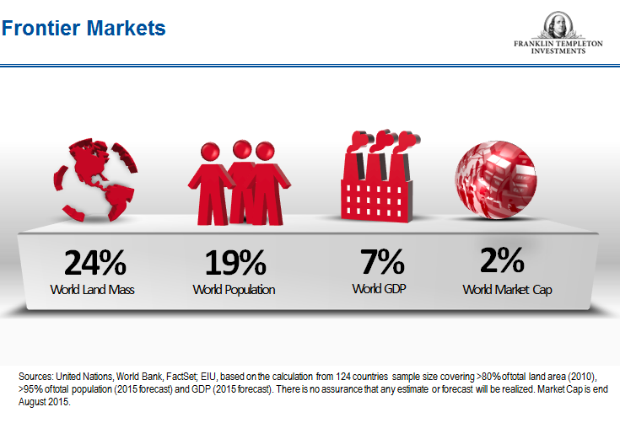
Frontier Markets

Slide 8
Where Emerging Markets Are
Eastern Europe
Eastern Asia
Latin America

Slide 9
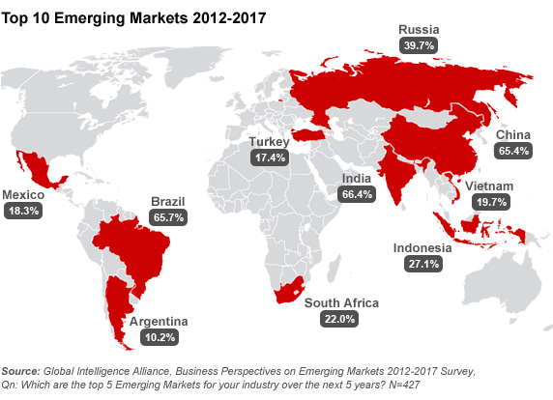
Top Ten Emerging Markets 2012-17

Slide 10
Where Frontier Markets Are: All Over The Map
They spread from Latin America to Asia, to Africa, and Central Europe.
They are large like Argentina and Kazakhstan and small like Estonia and Croatia.

Slide 11
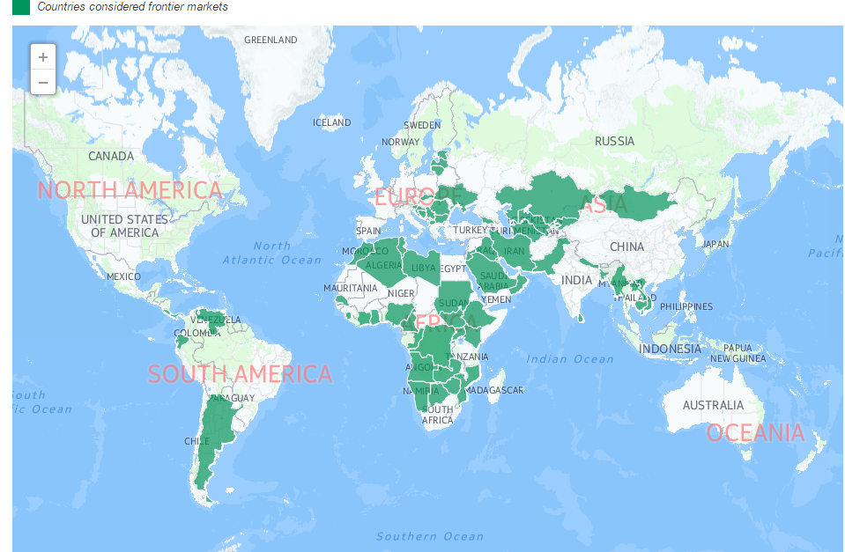
Where Frontier markets Are
http://topforeignstocks.com/

Slide 12
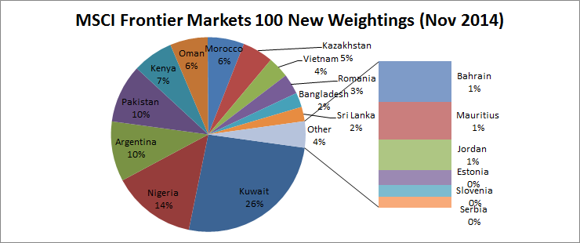
How Much Each Frontier Market Counts in MSCI
http://www.investmentfrontier.com/2014/06/11/change-good-msci-fixes-frontier-market-indexes/

Slide 13
What They Are--Formal Definitions
Markets that grow in size, and sophistication, in contrast to markets that are relatively inactive, with little change.
Emerging market can refer to a stock market in any developing economy, no mater how well developed the stock market itself may be, with the implication that the stock market’s potential to change is strongly linked to the economy’s overall potential.
International Finance Corporation

Slide 14
Another Definition
The financial markets of countries that are in growth stage of their development cycle and have low to middle per capita income.
Mark Mobius

Slide 15
Here Are Some Areas Where Emerging Economies Lag Behind Developed Countries
Lack of rule of law
Corporate governance rules
Accounting and taxation rules
Corruption and cronyism
Banking system
Exports rather than domestic demand is the primary engine of growth
Backward combinations of market and government institutions
Poor infrastructure

Slide 16
Lack of rule of law
In most emerging economies, property rights are poorly defined and enforced (e.g., Peru and the Philippines).
That makes it difficult to start and grow a business.
Nurtures corruption.
Discourages foreign investors.

Slide 17
Poor Corporate Governance
Corporate governance defines the relations among company stakeholders.
Poor corporate governance magnifies the “agency-problem.”
Undermines efficiency and competiveness.
Bad news for minority stockholders.

Slide 18
Poor Corporate Governance (continued)
In Mexico, the Philippines, Brazil, Russia, and Indonesia, large corporations are controlled by families (oligarchs) and labor unions.
In China, large corporations are either directly or indirectly controlled by the government.
That’s bad news for stockholders.

Slide 19
Accounting And Taxation
Accounting rules and procedures not well-defined
Corporate books cannot be trusted
Taxation rules are unclear
Breeds corruption
Magnifies uncertainty
Sited among the biggest competitiveness problems by the World Economic Forum

Slide 20
Corruption and Cronyism
Leads to creation of private and state monopolies that limit competition and innovation
Raise cost of living
Raise income inequalities and social tensions
Cause revolutions
Kill economic progress

Slide 21
Banking System
Owned or controlled by government and a few families
Abacus Banking
Misallocation of resources
Asset Bubbles
Financial crises

Slide 22
Exports Drive Growth
For most emerging markets, exports is the primary engine of growth (e.g., China, South Africa)
That places them at the whim of global markets
And the policies pursued in developed countries.

Slide 23
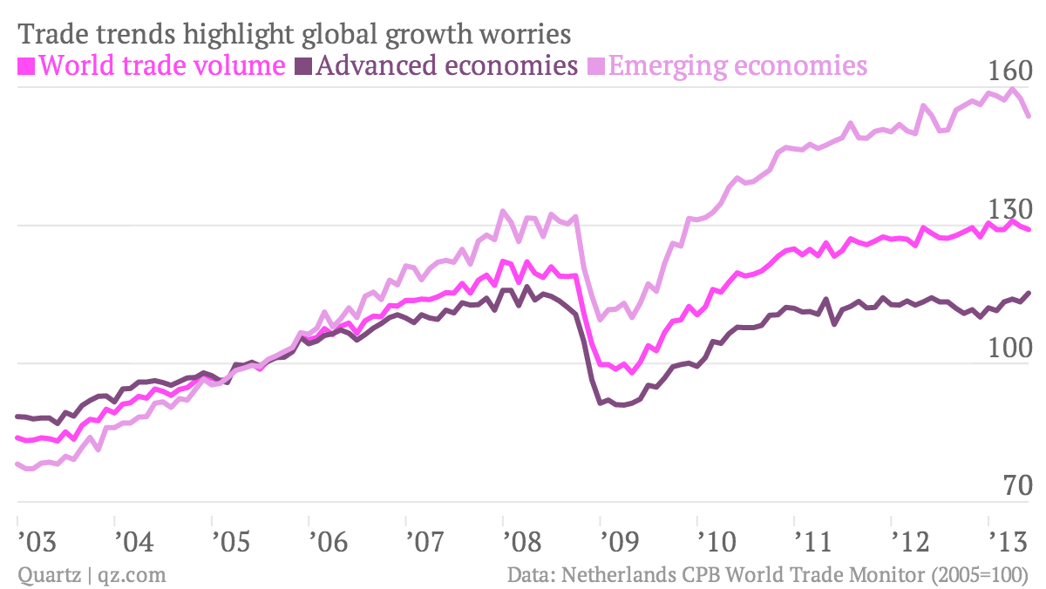
World Trade 2003-13
https://qz.com/120680/the-big-trade-switch-is-on-as-emerging-markets-export-less/

Slide 24
Backwards combination of markets and government
Markets and governments are deployed in areas that succeed rather than fail
In China, the government is present in business and private life, but absence from the commons.
http://www.forbes.com/sites/panosmourdoukoutas/2016/09/18/indias-semi-soviet-semi-latin-model/#1dcba7446d45
https://www.forbes.com/sites/panosmourdoukoutas/2017/07/02/what-makes-life-in-america-mexico-india-and-china-so-different-the-right-mix-of-institutions/#1e38f27f2675

Slide 25
Poor Infrastructure
Roads, bridges, ports and airports never finish (e.g., Philippines, and Brazil)
Hard to move people and commodities around
Lower productivity and competitiveness

Slide 26
Still EM Are Catching Up With:
Trade Liberalization—opening domestic markets to foreign competition—market discipline
Deregulation: Opening domestic markets to both domestic and foreign competition
Lifting interest rate controls and letting currencies float, making easier to absorb external shocks (e.g., a hike in US interest rates).
Privatization—selling government assets to investors
Better corporate governance
Economy and financial market size

Slide 27
Some Emerging Markets Have ”Graduated”
But they haven’t become developed
They remain rather “mature” emerging markets (e.g., BRICS)

Slide 28
While Others Emerging Have Made A Detour
Some emerging markets move backward from emerging to frontier, and sometimes, back to emerging, but never really graduate and become developed.
The primary reason is the meddling of government with the free flow of capital (e.g., capital controls)
Another reason is the shrinking of the size of the equity market.

Slide 29
Emerging Markets That Made The Detour
Sri Lanka (2001) removed from the MSCI due to the size of its equity market and added to the frontier markets index.
Pakistan (2008) removed from MSCI after the country initiated a price floor on stocks and added to the frontier index (2009).
Greece made a detour from emerging in 1988 to a developed 2001, and back to emerging in 2013 and frontier in 2015 (due to the size of its equity market and capital controls.
Argentina has made the detour several times over the last 100 years.

Slide 30
Mature Emerging Versus Immature (Emerging) Markets
Criteria | Mature | Emerging
Investment Range | Broad | Limited
Degree of Transparency | High | Low
Investor Protection | High | Low

Slide 31
MORE CLASSIFICATIONS OF Emerging Markets
The first examples that come to mind are Brazil, Russia, India, China, and South Africa (BRICS), though the list is longer, much longer, depending on the definition adopted. (See Appendix in Sharma’s book)
(IMF, BRICS+next eleven, FTSE,S&P)
http://www.bloomberg.com/news/photo-essays/2013-01-31/the-top-20-emerging-markets
http://ccsi.columbia.edu/publications/emgp/
Columbia University EMGP, and Bloomberg).
Other lists include the ten biggest emerging markets—alphabetically: Argentina, Brazil, China, India, Indonesia, Mexico, Poland, South Africa, and Turkey.

Slide 32
Bloomberg’s Top Ten Frontier Markets
Kenya
Myanmar
Romania
Argentina
Vietnam
Nigeria
Egypt
Saudi Arabia
Sri Lanka
Ghana

Slide 33
Morgan Stanley Capital International (MSCI) Classification
https://www.msci.com/market-classification

Slide 34
Some of The Criteria Behind the Classifications
Market Capitalization
Market float
Number of companies listed
Fairness and transparency rules
Foreign capital inflows

Slide 35
Why They Are Important:
Higher Returns And Diversification
Fast growth—Emerging markets grow exponentially vis-à-vis mature markets, which grow linearly.
In the last decade, all ten fastest growing economies were emerging market economies; and eight of those were frontier economies.
Fast growth means higher returns over the long term
That attracts global capital, as it searches for higher returns and diversification around the globe.

Slide 36
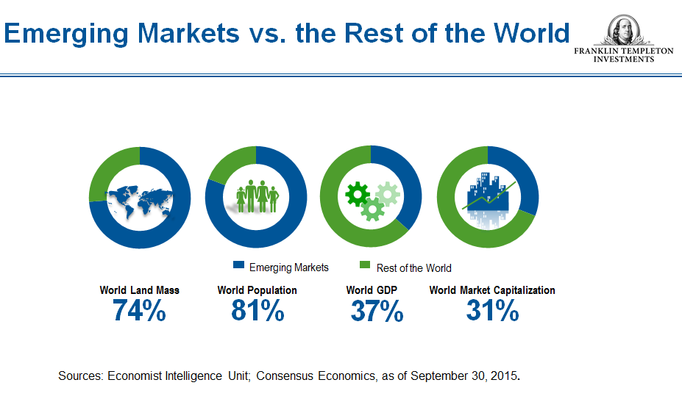
How Emerging Markets Compare To The Rest Of The World

Slide 37
India And China To Lead Emerging EM Economies

Slide 38
GEM outperformed Developed Markets over the last decade
International Stocks (ex-US) 19%
European Region 18%
US 9.1%
Emerging markets 26%
Latin America 25%
Pacific Region 27%

Slide 39
With Higher Returns Come Higher Risks
South Korea’s market gained 400% between 1986 and 1989, but dropped by 40% in 1990
Taiwan’s market gained 1000% between the beginning of 1987 and the beginning of 1990, but it lost 80% of its value by the end of 1990.
China’s stock market gained 600% for the period 2006-8
Greek stock market gained 500% in 1999-2000, but lost all most of it in the next three years. Now, it trades near all time low.
Brazil’s market, up 60% for the year, but has been performing terribly over the last five years.

Slide 40
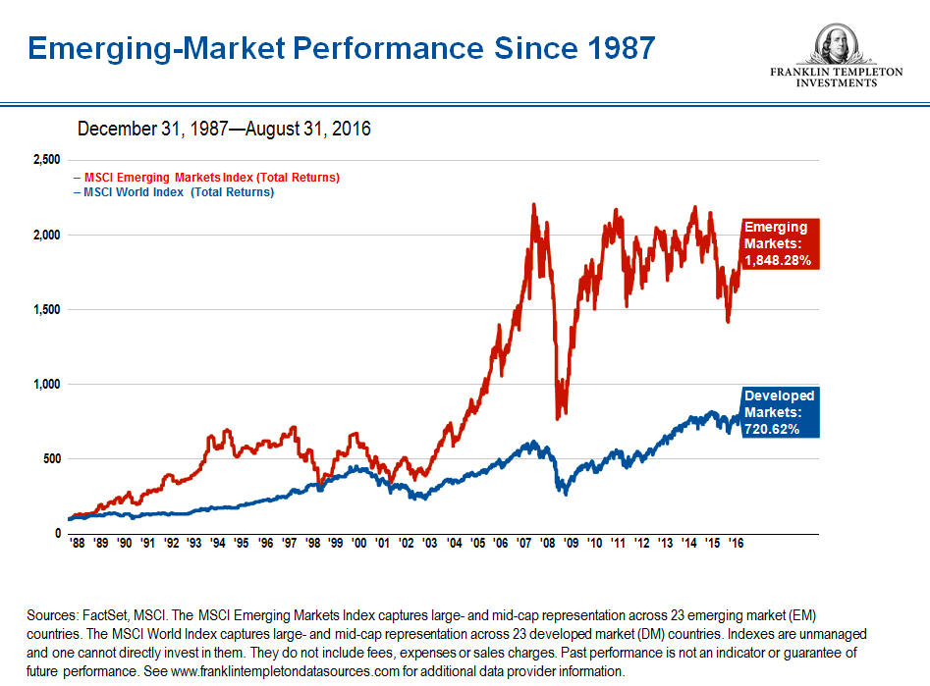
Emerging Market Performance Since 1987

Slide 41
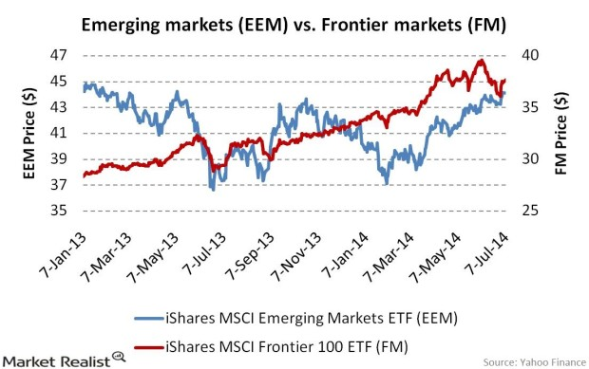
Emerging VERSUS Frontier market performance

Slide 42
What Drives Emerging Market Performance
Major political changes like the appointment of a pro-market pre-minister or finance minister
The resignation or impeachment of a pro-labor or socialist leader
Privatization and deregulation
Foreign capital inflows
Economic growth
Rising commodity prices—For commodity rich emerging market economies
A young, growing population, entering the workforce at home.

Slide 43
Market Volatility Around The World
http://www.investmentfrontier.com/2016/07/25/most-volatile-stock-markets-world/

Slide 44
Where To Invest (the macro factor)
Countries that have either current account surpluses or well funded deficits
Countries with a “normal” population pyramid
Avoid countries dependent on hot money that fuels bubbles
Avoid countries with “abnormal” population pyramids

Slide 45
Where To Invest (the micro factor)
Construction sector—EM need to build their infrastructure, and that creates good opportunities for companies that are engaged in this sector.
Consumer sector—The rise of a middle class creates demand for discretionary items like autos and appliances.
Banking sector—the growth in construction and consumer sectors fosters the development of financial intermediaries and financial markets
The development of financial markets allows EM governments and corporations to issue debt.

Slide 46
How To Invest In Emerging Markets
Buy commodities—many EM are commodity exporters
Buy debt—EM debt pays higher rates
Buy a diversified fund like EEM or a Mutual Fund like Templeton’s Emerging Market Fund (TAEMX)
http://finance.yahoo.com/chart/EEM
Buy into individual country funds like DEM, EWZ, IFN,RUSS
Buy into individual companies listed in US exchanges like PBR, BABA, and CML, ASA
Buy companies listed in the local exchanges
Buy large multinationals that benefit from rising trade flows between emerging global economies and mature economies (consumer companies).

Slide 47
Like:
Caterpillar—sells construction and mining equipment to China
Yum Brands—The parent company of Kentucky Fried Chicken and Pizza Hut—big in China
McDonald’s and Coca Cola—popular brands
Starbucks—China is the “next frontier”
You can also buy smaller companies from emerging markets that have exposure to large emerging markets

Slide 48
Like:
Costamare, which has a big exposure to China.
Long term leases with Chinese manufacturers
High profit margins
Strong free cash flow
Good dividend
http://finance.yahoo.com/q;_ylt=AhggmcNL3AgkL22ySiHeFBbkNbkF;_ylu=X3oDMTExZTAwYTJjBHBvcwMxBHNlYwN5ZmlRdW90ZXNUYWJsZQRzbGsDY21yZQ--?s=CMRE

Slide 49
Like Mercado Libre
Big exposure to Latin American markes

Slide 50
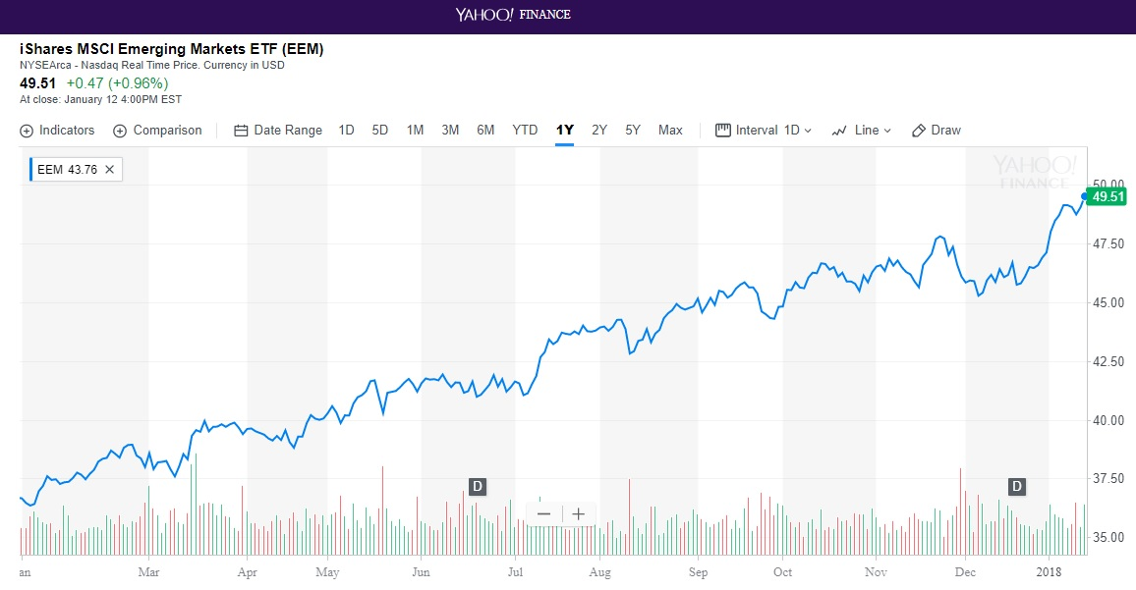
Buy Exchange Traded Funds (ETFs)

Slide 51
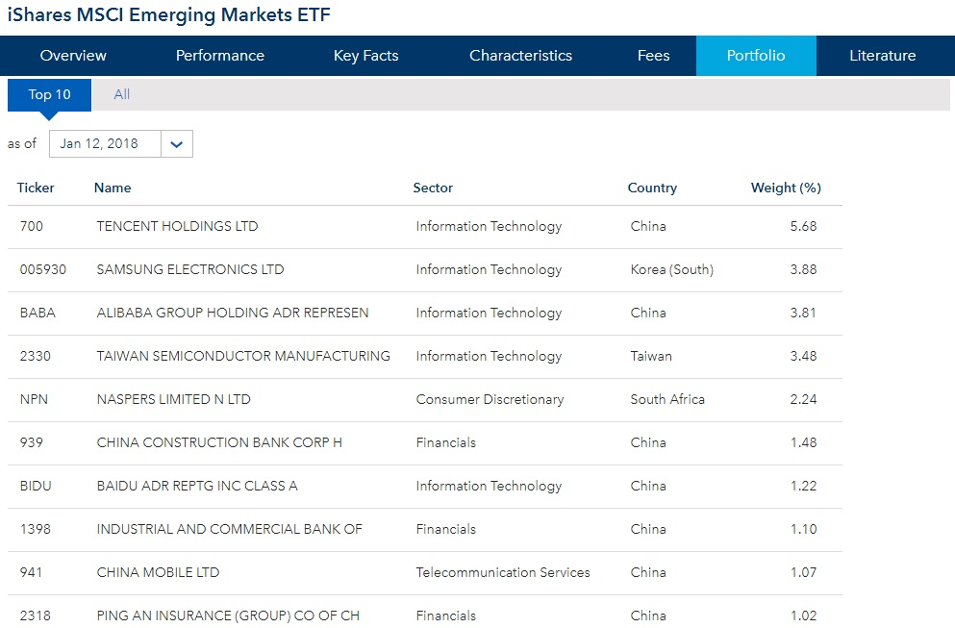
iShares EEM ETF

Slide 52
Top Performing Emerging Market Funds
Fund/ETF/Index | YTD Return
1.Guggenheim China Technology (CQQQ) | 74%
2.KraneShares CSI China Internet (KWEB) | 69.6
3.EMQQ Emerging Markets Internet Ecommerce (EMQQ) | 68.4
4. Global X Solactive China Consumer Index (CHIQ) | 66.3
5. Market Vectors India Small-Cap Index (SCIF) | 65.4
6. iShares MSCI India Small Cap (SMIN) | 60.5
7. Powershares Golden Dragon China (PGJ) | 59.9
8.Global X MSCI Argentina (ARGT) | 54.4
9.Market Vectors Brazil Small-Cap | 54.00
10.Columbia India Consumer (INCO) | 52.32
https://www.forbes.com/sites/panosmourdoukoutas/2017/10/09/chinese-internet-shares-on-fire-for-how-long/#29cc4ff67a40

Slide 53
KraneShares SCI China Internet ETF Top 5 Holdings
Company/ETF | YTD %Change
KraneShares SCI China Internet ETF | 65.58
Alibaba Group | 102.73
Sina Corp | 88.10
Tencent | 84.47
Powershares QQQ | 23.31
https://www.forbes.com/sites/panosmourdoukoutas/2017/10/09/chinese-internet-shares-on-fire-for-how-long/#29cc4ff67a40

Slide 54
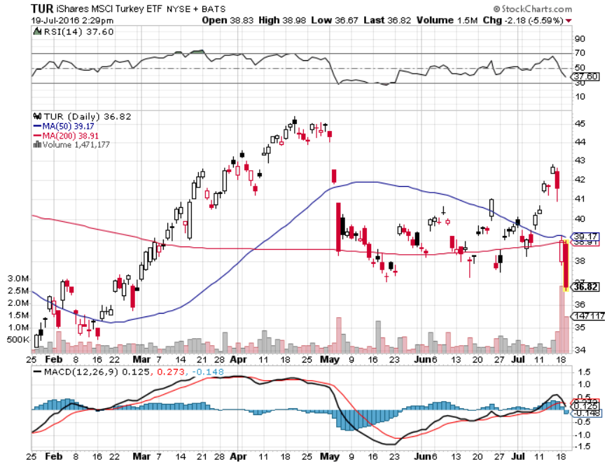
Turkish iShares
http://www.etftrends.com/wp-content/uploads/2016/07/tur.png

Slide 55
Limitations Of Emerging Market Investing
In addition to traditional investment risks, investing in emerging markets involves accounting risks, currency risks, political risks, arbitrary taxation risks, nationalization risks (eg., Corimon).
Low trading volume makes it difficult to get in and out the market without affecting prices.
A high concentration of shares and lack of transparency makes emerging markets conducive to insider trading.

Slide 56
Mark Mobius Felt Rule
Fair—Are all investors treated equally?
Efficient—Can investors buy and sell shares easily and safely?
Liquid—Is there sufficient turnover or volume to be able to buy and sell shares in the market?
Transparent—Is it easy to find out what’s really going on in this market?

Slide 57
When An Emerging Market Becomes A Mature Market
Easier to Invest
--broadly followed
--many investment vehicles
Easier to Trade
--larger capitalization
--larger trading volume (liquidity).

Slide 58
In Sum:
The major difference between emerging and frontier markets on the one side and developed markets on the other isn’t in per capita GDP, but in the institutions and policies of the two groups.
Most of the emerging markets never emerge, held back by corruption, inflation, and revolution, though not necessary in the same order.

Slide 59
Why Most Emerging Markets Never Become Developed
Corruption
Inflation
Revolution
Though not always in the same order

Slide 60
Case Study: How To Make A Killing On Both Sides Of The Market
J. Kyle Bass—short Greek government debt
https://www.valuewalk.com/2012/03/kyle-bass-stands-to-make-700000-on-greek-credit-default-swap-payout/#.T1wPVjHCkhU
Paul Kazarian—Japonica Partners—bought distressed Greek government debt.
https://greece.greekreporter.com/2016/12/10/greece-largest-private-debt-owner-says-greek-debt-is-much-lower-than-we-think-video/
Can you think of an EM where such opportunities exist right now?
GET READY TO DISCUSS THIS CASE STUDY IN THE NEXT CLASS

